Slide 1

Software Design and Analysis Class Diagram
Department of Computer Science
National University of Computer and Emerging Sciences

Slide 2
What is a Class Diagram
Class diagram is a static diagram.
It represents the static view of an application.
Class diagram is not only used for visualizing, describing, and documenting different aspects of a system
But also for constructing executable code of the software application.

Slide 3
What is a Class Diagram
Class diagram describes the attributes and operations of a class and also the constraints imposed on the system.
The class diagrams are widely used in the modeling of object-oriented systems
because they are the only UML diagrams.
which can be mapped directly with object-oriented languages.

Slide 4
What is a Class Diagram
Class diagram shows a collection of:
Classes
Interfaces
Associations
Collaborations
Constraints.
It is also known as a structural diagram.

Slide 5
How to Draw a Class Diagram?
The following points should be remembered while drawing a class diagram.
The name of the class diagram should be meaningful to describe the aspect of the system.
Each element and their relationships should be identified in advance.
Responsibility (attributes and methods) of each class should be clearly identified
For each class, minimum number of properties should be specified, as unnecessary properties will make the diagram complicated.
Use notes whenever required to describe some aspect of the diagram.
At the end of the drawing it should be understandable to the developer/coder.
Finally, before making the final version, the diagram should be drawn on plain paper and reworked as many times as possible to make it correct.

Slide 6
Basic Components of a Class Diagram
The standard class diagram is composed of three sections:
Upper section:
Contains the name of the class.
This section is always required.
Middle section:
Contains the attributes of the class.
Use this section to describe the qualities of the class.
This is only required when describing a specific instance of a class.
Bottom section:
Includes class operations (methods).
Displayed in list format, each operation takes up its own line.
The operations describe how a class interacts with data.

Slide 7
Attributes & Operations
Attributes:
A significant piece of data containing values that describe each instance in the class.
Also called fields, variables, or properties.
Methods:
Also called operations or functions.
Allow you to specify any behavioral feature of the class.

Slide 8
Member access modifiers
All classes have different access levels depending on the access modifier (visibility).
Here are the access levels with their corresponding symbols:
Public (+)
Private (-)
Protected (#)

Slide 9
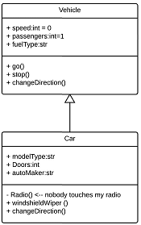
Interactions
The term "interactions" refers to the various relationships and links that can exist in class diagram.
Some of the most common interactions include:
Inheritance:
The process of a child or sub-class taking on the functionality of a parent or superclass, also known as generalization.
It's symbolized with a straight connected line with a closed arrowhead pointing towards the superclass.

Slide 10
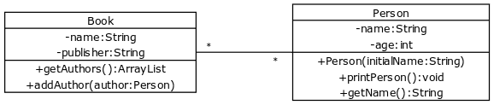
Interactions
Bidirectional:
Both classes are aware of each other and their relationship with the other.
This association is represented by a straight line between two classes.
Below is an example where a book knows about its author and a person knows about a book they have written.

Slide 11
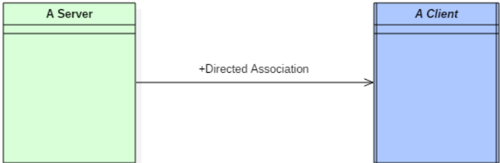
Interactions
Unidirectional:
One class is aware of the other and interacts with it.
Unidirectional association is modeled with a straight connecting line that points an open arrowhead from the knowing class to the known class.

Slide 12
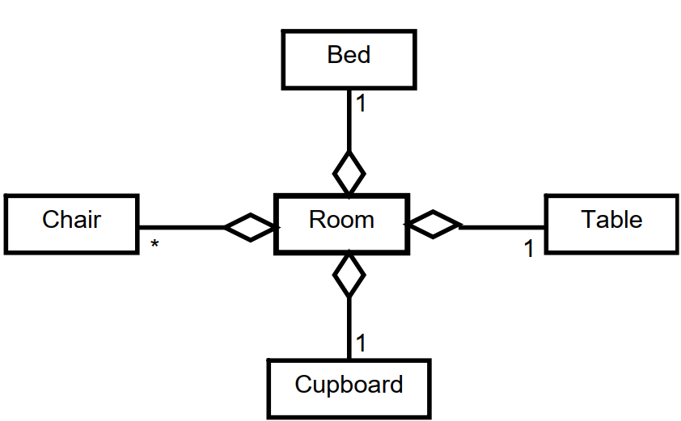
Interactions
Aggregation:
An object may contain a collection (aggregate) of other objects.
The relationship between the container and the contained object is called aggregation.
Aggregation is represented by a line with unfilled-diamond head towards the container.
Aggregation is weaker relationship, because
Aggregate object is not a part of the container.
Aggregate object can exist independently.

Slide 13
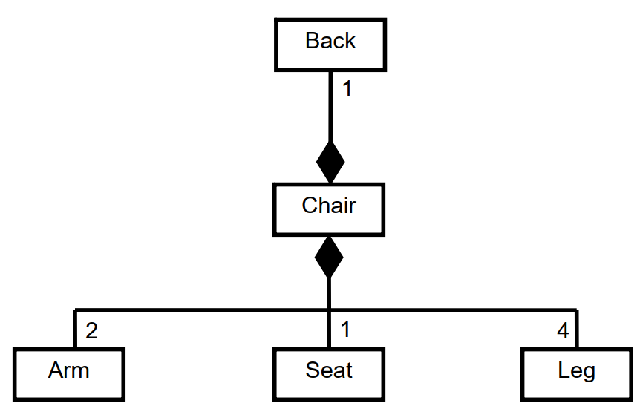
Interactions
Composition:
An object may be composed of other smaller objects.
The relationship between the “part” objects and the “whole” object is known as Composition.
Composition is represented by a line with a filled-diamond head towards the composer object.
Composition is stronger relationship:
Composition is a stronger relationship, because
Composed object becomes a part of the composer
Composed object can’t exist independently

Slide 14
Multiplicity
0..1: Zero to One
n: Specific number
0..*: Zero to many
1..*: One to many
n..m: Specific number range

Slide 15
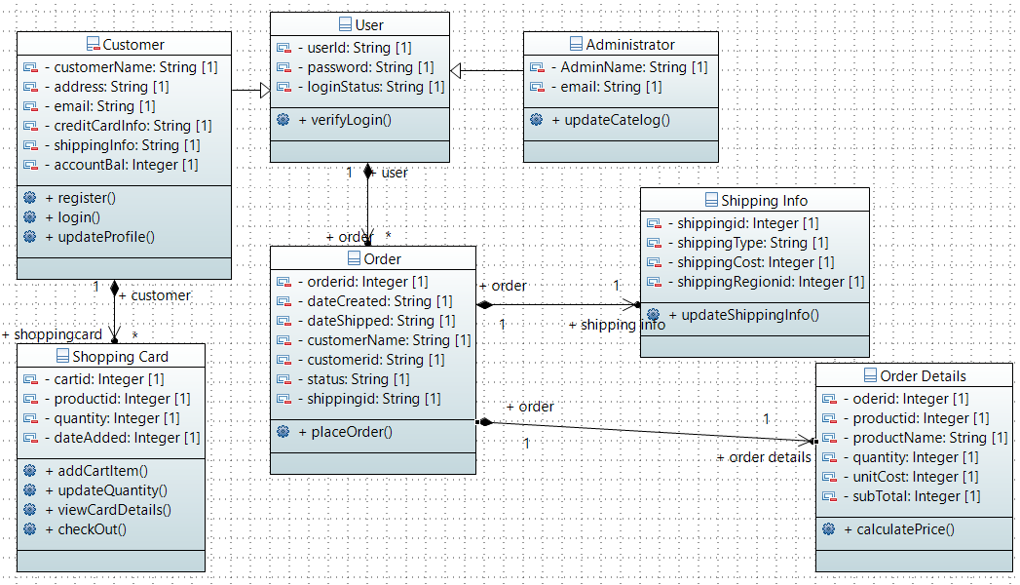

Slide 16
End of Lecture Any Question ?

